Slide 1
ChildTag: An Enhanced Object Tracker IoT Device
Group 3: Tianyi Xu / Zhixuan Zhang /Yicheng Feng
Notes:
Good evening, everyone. Today, we’re so excited to present our project proposal-- Child Tag, which is a real-time monitoring device designed to ensure the safety and well-being of children. Through this device, parents can easily monitor their baby or kids.

Slide 2
Project Overview
ChildTag
A real-time monitoring device designed to ensure the safety and well-being of children.
Function:
Location information
Safety range alarm
Motion state detection
Step counts
Photo/video
Just Fall down behind you 500 ft
Notes:
Our project aims to realize the following function:
1.Real-time location tracking to always know where the monitored individuals are.
2.setting up a safety range alarm to get alerted if the individual steps out of a predefined safe zone.
3.Activity monitoring to understand their physical status, whether they are running, walking, or still. And we will also try to add step counts and fall detection function. These will help keep children safe.
4.Real-time photo and video upload to have a visual check when necessary.

Slide 3
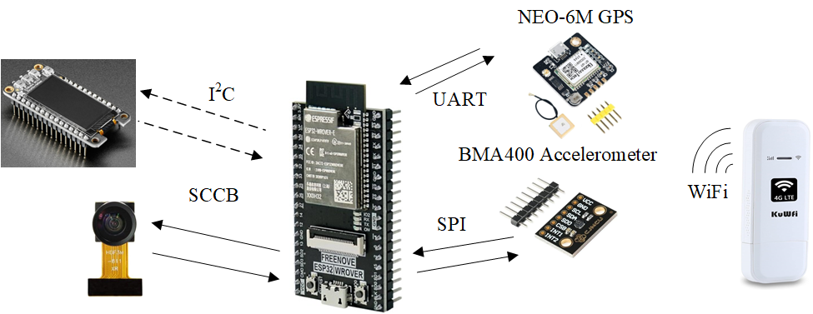
Interact Diagram
Notes:
Here is the interact diagram of sensors and chips. The main chip in the middle is ESP32, it communicates with GPS module by UART to get location data, and uses SPI to connect to accelerometer to measure acceleration, analyzes real-time motion of the kid. The KuWiFi modem provide WiFi signal for the whole system. And ESP32 uses SCCB to communicate with camera. SCCB is a protocal similar to I2C. We have little knowledge about this protocol but the provider of the chip gives us tutorial and library about it. The screen may not be necessary but we will consider extend some functions in the future.

Slide 4
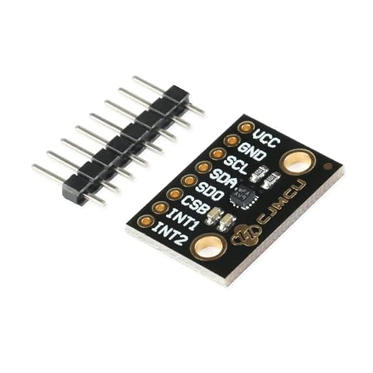
Accelerometer: BMA400
SPI Connection
Connect the SDI (Data Input) pin of the BMA400 to the MOSI (Master Output Slave Input) pin on the ESP32.
Connect the SDO (Data Output) pin of the BMA400 to the MISO (Master Input Slave Output) pin on the ESP32.
Connect the SCK (Clock) pin of the BMA400 to the SCK (Clock) pin on the ESP32.
Connect the CS (Chip Select) pin of the BMA400 to any designated CS pin on the ESP32.
[3]https://www.bosch-sensortec.com/products/motion-sensors/accelerometers/bma400/
Notes:
To track physical activities, we've incorporated the BMA400 accelerometer from BOSCH. This ultra-low-power, high-performance sensor can detect motions like running, walking, standing or still, and also helps in counting steps and detecting falls, ensuring a comprehensive monitoring​.

Slide 5
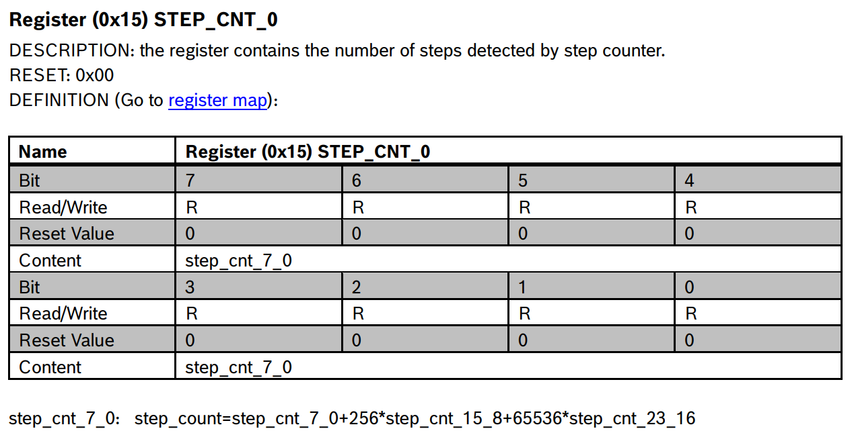
Accelerometer: BMA400
[3]https://www.bosch-sensortec.com/products/motion-sensors/accelerometers/bma400/
Notes:
To track physical activities, we've incorporated the BMA400 accelerometer from BOSCH. This ultra-low-power, high-performance sensor can detect motions like running, walking, standing or still, and also helps in counting steps and detecting falls, ensuring a comprehensive monitoring​.

Slide 6
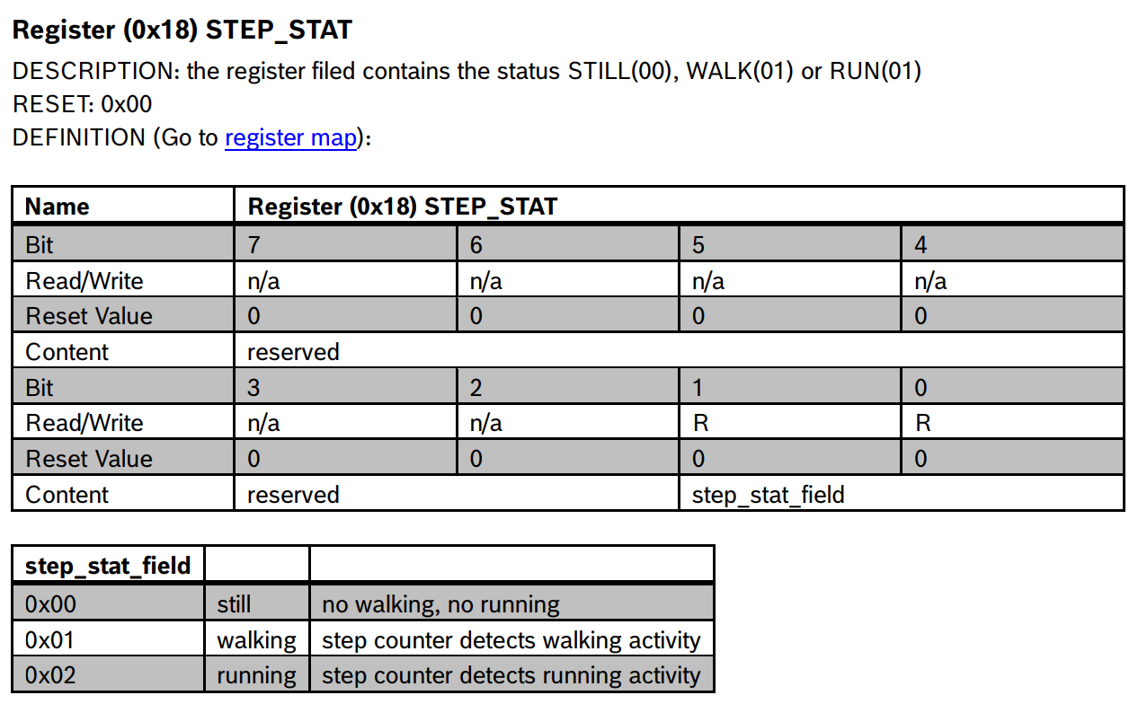
Accelerometer: BMA400
[3]https://www.bosch-sensortec.com/products/motion-sensors/accelerometers/bma400/
Notes:
To track physical activities, we've incorporated the BMA400 accelerometer from BOSCH. This ultra-low-power, high-performance sensor can detect motions like running, walking, standing or still, and also helps in counting steps and detecting falls, ensuring a comprehensive monitoring​.

Slide 7
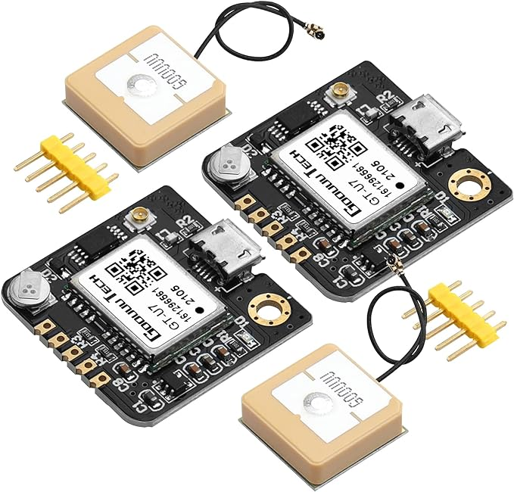
GPS Module: NEO-6M
UART Connection
Connect the TX (Transmit) pin of the NEO-6M to the RX (Receive) pin of the ESP32.
Connect the RX (Receive) pin of the NEO-6M to the TX (Transmit) pin of the ESP32.
[4] https://www.u-blox.com/en/product/neo-6-series
Notes:
For precise location tracking, we've chosen the NEO-6M GPS module. With its technology and under one-second time-to-first-fix capability, we can obtain accurate location data swiftly. Moreover, its power-saving mode ensures longer device operation without frequent recharging​

Slide 8
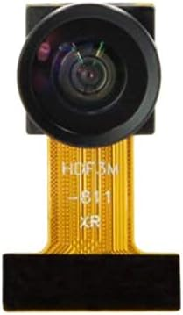
Camera - ESP32-CAM
SIOD (Serial Data) Pin: The I2C data line, used for transmitting control and configuration data.
SIOC (Serial Clock) Pin: The I2C clock line, used for synchronizing data transmission.
VSYNC (Vertical Sync) Pin: Used to indicate the start of an image frame.
HREF (Horizontal Reference) Pin: Used to indicate the start and end of a line of pixel data.
PCLK (Pixel Clock) Pin: Used to synchronize the transmission of pixel data.
D0-D7 (Data Pins): These pins are used for transmitting image data. For an 8-bit data bus, there are typically D0 to D7, making up 8 pins in total.
RESET Pin (if available): Used to reset the camera module.
XCLK (External Clock) Pin: Provides an external clock signal to the camera module.
Notes:
For visual monitoring, we’ve chosen the ESP32-CAM module. It houses an OV2640 camera, ideal for clear imaging and video capturing. The module supports WiFi video monitoring and image uploads, keeping caretakers visually connected with their kids.​

Slide 9
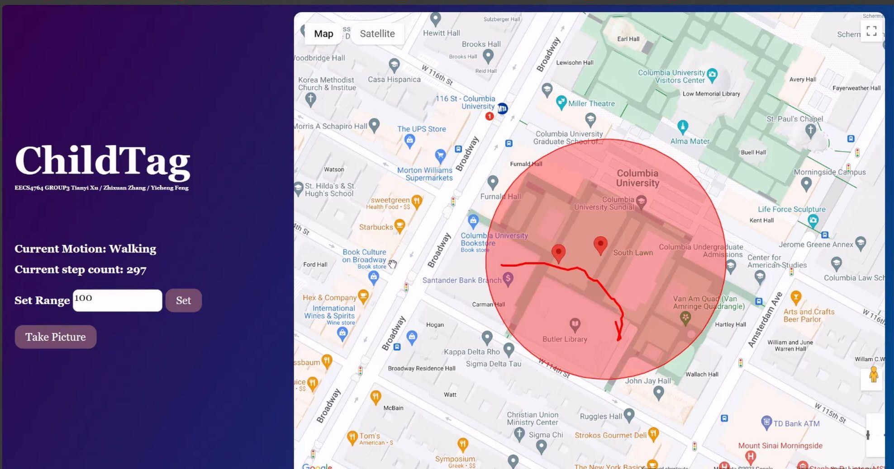
Developer Version to Product Version
Call Google Maps API
Map initialization function：
-> google.maps.Map
Place Marker founction:
-> google.maps.Marker
Show Image founction:
-> google.maps.InfoWindow
Draw the Range function:
-> google.maps.Circle
Draw tracking Path function:
-> google.maps.Polyline
Out of Range alarm function:
-> google.maps.Geocoder
Notes:
For precise location tracking, we've chosen the NEO-6M GPS module. With its technology and under one-second time-to-first-fix capability, we can obtain accurate location data swiftly. Moreover, its power-saving mode ensures longer device operation without frequent recharging​

Slide 10
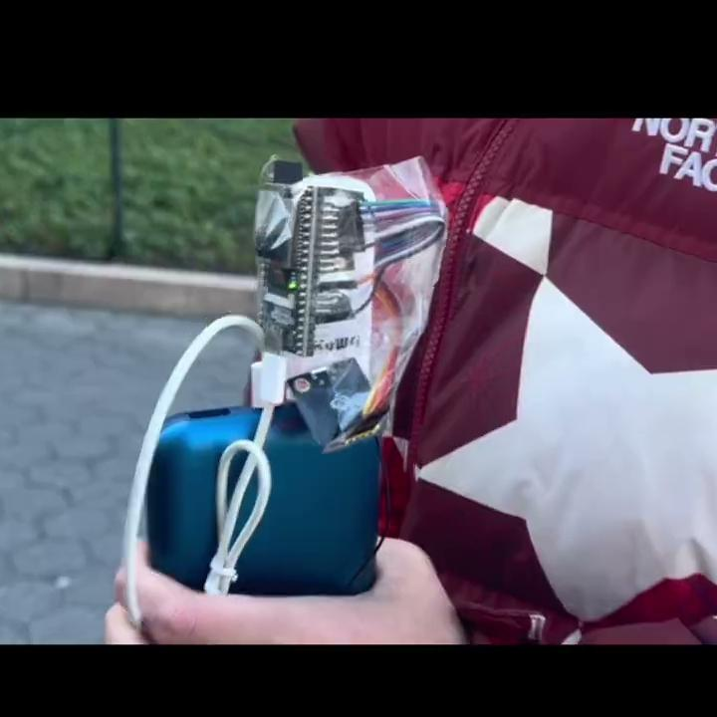
Project Demo
Notes:
For precise location tracking, we've chosen the NEO-6M GPS module. With its technology and under one-second time-to-first-fix capability, we can obtain accurate location data swiftly. Moreover, its power-saving mode ensures longer device operation without frequent recharging​

Slide 11
Web frontend
PCB?
Appearance?
More stable GPS?
Notes:
For precise location tracking, we've chosen the NEO-6M GPS module. With its technology and under one-second time-to-first-fix capability, we can obtain accurate location data swiftly. Moreover, its power-saving mode ensures longer device operation without frequent recharging​

Slide 12
Q&A
Notes:
Now is the Q and A time. Do you have any questions?

Slide 13
Thanks

